Slide 1
SQL Server 2016
New Feature Preview
2015-10-10
@RileyMajor

Slide 2
SQL Saturday #453
Thank you Sponsors!
Please visit the sponsors during the vendor break from 2:45 – 3:15 and enter their end-of-day raffles
Event After Party
Dave and Buster’s in Southdale Center. 3rd floor by Macy’s starting at 6:15
Want More Free Training?
PASSMN meets the 3rd Tuesday of every month. https://mnssug.org/

Slide 3
SQL Saturday #453
Twitter
@PASSMN
#SQLSatMN

Slide 4
Presentation Overview
Brief History of SQL Server
New Features in 2016
JSON
Temporal Tables
Interactive Query Plans
Getting Started with 2016
Future Thoughts
Bio
Notes:
Caveats: I talk mostly about the database engine (as opposed to business intelligence), and from the perspective of a developer at a smaller shop.

Slide 5
Birth of SQL Server
Started with Ashton Tate (dBase) and Sybase
Version 1 Shipped in 1989
Ditched Ashton Tate with dBase IV failure
Version 1.1 Shipped in 1990 – Sybase adds support for Windows
Version 4.2 Shipped in 1992 – First significant Microsoft involvement
Notes:
My first databases were built with dBase IV. I made a database of states and people in my class. I even had a spot for pictures.
http://blogs.msdn.com/b/euanga/archive/2006/01/19/sql-mythbusters-sql-server-is-really-a-sybase-product-not-a-microsoft-one.aspx
https://en.wikipedia.org/wiki/Microsoft_SQL_Server
https://en.wikipedia.org/wiki/Ashton-Tate
https://en.wikipedia.org/wiki/Borland
https://en.wikipedia.org/wiki/Sybase

Slide 6
SQL Server on Windows
Parted with Sybase in 1993
Focused on Windows only.
Version 6 shipped in 1996 – No further Sybase involvement.
Version 7 shipped in 1998 – DTS Packages, OLAP tools.
SQL Server 2000 – User-Defined Functions, Reporting and Analysis Services
Notes:
http://blogs.msdn.com/b/euanga/archive/2006/01/19/sql-mythbusters-sql-server-is-really-a-sybase-product-not-a-microsoft-one.aspx
https://en.wikipedia.org/wiki/Ashton-Tate
https://en.wikipedia.org/wiki/Borland
https://en.wikipedia.org/wiki/Sybase

Slide 7
SQL Server Grows Up
SQL Server 2005 (v9)
Sybase Code “completely rewritten”.
SSMS
XML
TRY/ CATCH
APPLY Operator, Common Table Expressions
varchar(max)
OUTPUT Clause
PIVOT, Ranking Window Functions (ROW_NUBER; OVER)
Encryption, Hashing
Dynamic Management Views (DMVs), DDL Triggers, Query Notifications
Database Mirroring, Service Broker, SSIS, Database Mail, CLR
Database Snapshots*, Table Partitioning*, Online Index Operations*, Mirrored Backups*
Notes:
“Dave Campbell was talking the other day about some of the aspects of his more than 10 years in SQL Server, there are still folks in the team that have been here longer than him and yet almost all of the 1000 people who now work on SQL Server (caveat, this includes the MDAC, System.Data, System.XML and WinFS teams) have never seen a line of code that was written by anyone other than an MS employee.”
http://blogs.msdn.com/b/euanga/archive/2006/01/19/sql-mythbusters-sql-server-is-really-a-sybase-product-not-a-microsoft-one.aspx
All of these are standard edition except for Database Snapshots, Table Partitioning, Online Index Operations
Features Supported by the Editions of SQL Server 2005
https://technet.microsoft.com/en-us/library/ms143761(v=sql.90).aspx
Paul Randal survey: as of 2013, 41% still running 2005.
http://www.sqlskills.com/blogs/paul/build-numbers-survey-results/
RockSolid SQL survey: as of 2013, vast majority on 2008 R2.
http://www.rocksolidsql.com/dNews/sql_server_2012_where_is_the_love.aspx
Top 10 Advanced Features of SQL Server 2005
http://www.techrepublic.com/article/top-10-advanced-features-of-sql-server-2005/

Slide 8
The Hits Keep Coming
SQL Server 2008 (v10)
Date and Time Data Types
VALUES (Table Value Constructor)
Extended Events
Table-Valued Parameters
MERGE
HIERARCHYID
Geography and Geometry Spatial Data Types
Filtered Indexes
Grouping Sets
Change Data Capture*
Compression*
Resource Governor*
Transparent Data Encryption*
Notes:
SQL Server 2008 - What's New
https://technet.microsoft.com/en-us/magazine/2008.04.overview.aspx
Features Supported by the Editions of SQL Server 2008
https://msdn.microsoft.com/en-us/library/cc645993(v=sql.100).aspx
10 New SQL Server 2008 Features
http://www.databasejournal.com/features/mssql/article.php/3816486/10-New-SQL-Server-2008-Features.htm

Slide 9
There is no SQL Server 2010
SQL Server 2008 R2 (v10.5)
Compression for Standard (Log/Backup only)
BI Tooling (Reporting Services, PowerPivot)
Master Data Services*
StreamInsight**
Well, it was only a point release.
Last Chance for Slot-based Licensing
Notes:
SQL Server 2008 R2 New Features
http://sqlmag.com/sql-server-2008/sql-server-2008-r2-new-features
Top 10 Features of SQL 2008 R2
http://www.databasejournal.com/features/mssql/article.php/3857466/Top-10-Features-of-SQL-2008-R2.htm
Features Supported by the Editions of SQL Server 2008 R2
https://msdn.microsoft.com/en-us/library/cc645993(v=sql.105).aspx

Slide 10
That’s a little better…
SQL Server 2012 (v11)
TRY_PARSE, PARSE, TRY_CONVERT
FORMAT
CHOOSE, IIF
THROW
OFFSET / FETCH
Window Function Enhancements (LAG, LEAD)
User-Defined Server Security Roles
Contained Databases
AlwaysOn*
Columnstore Indexes*
Analysis Services Tabular Model*
Notes:
Features Supported by the Editions of SQL Server 2012
https://technet.microsoft.com/en-us/library/cc645993(v=sql.110).aspx
My Top 5 SQL Server 2012 Features by Aaron Bertrand, Guest Blogger
http://blogs.technet.com/b/dataplatforminsider/archive/2011/11/01/my-top-5-sql-server-2012-features-by-aaron-bertrand-guest-blogger.aspx
The Performance of the T-SQL Window Functions
https://www.simple-talk.com/sql/t-sql-programming/the-performance-of-the-t-sql-window-functions/
SQL Server Enterprise Edition Features You Didn’t Know You Could Use
http://www.datavail.com/category-blog/sql-server-enterprise-edition-features/
THE CASE FOR SQL SERVER 2012 ENTERPRISE (VS. STANDARD) EDITION
http://www.midnightdba.com/Jen/2014/03/the-case-for-sql-server-2012-enterprise-vs-standard-edition/

Slide 11
DENY on T_SQL
SQL Server 2014 (v12)
Backup to Azure
Delayed Durability
Encrypted Backups
Buffer Pool Extension (SSD Cache)
Updatable Columnstore Indexes*
In-Memory OLTP (Hekaton)*
Notes:
I was going to use the phrase “Where’s the beef?” for the title, but would most of the audience even get that? Also, there’s beefy stuff here; just not T-SQL related.
Features Supported by the Editions of SQL Server 2014
https://msdn.microsoft.com/en-US/library/cc645993(v=sql.120).aspx
What's New (Database Engine)
https://msdn.microsoft.com/en-US/library/bb510411(v=sql.120).aspx
Important New Features in SQL Server 2014
http://sqlmag.com/sql-server-2014/sql-server-2014-important-new-features
Top Ten: New Features in SQL Server 2014
http://windowsitpro.com/sql-server-2014/top-ten-new-features-sql-server-2014
(Almost) Everything You Need to Know About SQL Server 2014
http://www.brentozar.com/archive/2013/06/almost-everything-you-need-to-know-about-the-next-version-of-sql-server/

Slide 12
The New and Shiny
SQL Server 2016
Query Store
Dynamic Data Masking
JSON
Temporal Tables
Live Query Statistics
Always Encrypted
Multiple Secondary Readers for Load Balancing
R Algorithms in SQL
Stretch Database (Auto-Archive to Azure)
Row-Level Security
Automatic TempDB Optimization
PolyBase (T-SQL for Hadoop)
Notes:
SQL Server 2016 Datasheet
http://download.microsoft.com/download/F/D/3/FD33C34D-3B65-4DA9-8A9F-0B456656DE3B/SQL_Server_2016_datasheet.pdf
SQL Server 2016 CTP Technical Deep Dive
http://www.slideshare.net/idigdata/sql-server-2016-ctp-technical-deep-dive
Announcing Row-Level Security in Azure SQL Database
http://www.brentozar.com/archive/2015/01/announcing-row-level-security-sql-server/
Reading the SQL Server 2016 Data Sheet
http://www.brentozar.com/archive/2015/05/reading-the-sql-server-2016-data-sheet/
What's New in SQL Server 2016, September Update
https://msdn.microsoft.com/en-us/library/bb500435.aspx?f=255&MSPPError=-2147217396
What's New in Database Engine
https://msdn.microsoft.com/en-US/library/bb510411(v=sql.130).aspx
SQL Server 2016 Community Technology Preview 2.4 is available
http://blogs.technet.com/b/dataplatforminsider/archive/2015/09/30/sql-server-2016-community-technology-preview-2-4-is-available.aspx
10 New Features Worth Exploring in SQL Server 2016
http://www.databasejournal.com/features/mssql/10-new-features-worth-exploring-in-sql-server-2016.html
Top 7 Features Coming to SQL Server 2016
https://redmondmag.com/articles/2015/06/03/features-to-sql-server-2016.aspx

Slide 13
Cha-ching!
Query Store – store ALL the query plans!
Your plan cache is only so big, but your disks are bigger.
Why recompute when you can reload?
Reboot? Would you like me to warm that cache up for you?
Don’t like this new plan? Return it for a full refund!
Notes:
Monitoring Performance By Using the Query Store
https://msdn.microsoft.com/en-us/library/dn817826.aspx

Slide 14
<REDACTED>
Dynamic Data Masking hides sensitive information (such as personally-identifiable information– PII) from normal users.
There are a variety of masking functions which turn text into XXXX, dates into 2000-01-01, etc.
UNMASK permissions are required to see real data.
Notes:
Dynamic Data Masking
https://msdn.microsoft.com/en-us/library/mt130841.aspx

Slide 15
Hold this but don’t look inside!
Always Encrypted hides data even from DBAs.
Encryption keys live with application.
Performance issues slightly mitigated with repeatable encryption, but that weakens security.
Suggested for use with external DBA resources.
Notes:
Always Encrypted
https://msdn.microsoft.com/en-us/library/mt163865.aspx

Slide 16
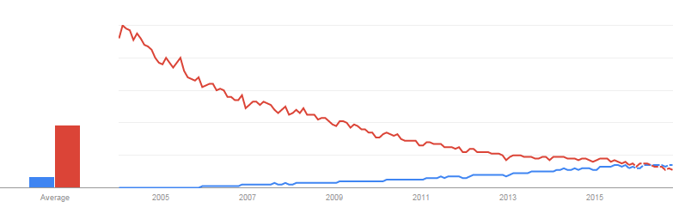
JSON
Why?
What?
XML
JSON
[
{
“MyField1”: “MyValue”,
“MyField2”: 123.45
},
{
“MyField1”: “MyValue2”,
“MyField2”: 345.67
}
]
Notes:
Google Search Trend
https://www.google.com/trends/explore#q=json%2C%20xml&cmpt=q&tz=Etc%2FGMT%2B5
Look at the timing. SQL Server 2005’s XML support came at the apex of XML popularity. SQL Server 2016’s JSON support comes just as JSON surpasses XML.
JSON’s data format is rooted in JavaScript syntax. It’s an array of objects. Each object has properties.
References:
JSON Data (SQL Server)
https://msdn.microsoft.com/en-us/library/dn921897.aspx
Format Query Results as JSON with FOR JSON (SQL Server)
https://msdn.microsoft.com/en-us/library/dn921882.aspx
SQL Server 2016 : JSON Support
By Aaron Bertrand on May 11, 2015 in T-SQL
http://blogs.sqlsentry.com/aaronbertrand/sql-server-2016-json-support/
How the New JSON Support Will Work in SQL Server 2016
https://visualstudiomagazine.com/blogs/data-driver/2015/05/sql-server-json-support.aspx

Slide 17
JSON vs XML – Sample Data
DECLARE @Orders TABLE
(
OrderID bigint IDENTITY,
OrderDate datetime
);
DECLARE @OrderDetails TABLE
(
OrderDetailsID bigint IDENTITY,
OrderID bigint,
ProductID varchar(50),
Qty int
);
OrderID | OrderDate | ProductID | Qty
1 | 2015-10-10 | Bike | 2
1 | 2015-10-10 | Helmet | 2
1 | 2015-10-10 | Wheels | 4
2 | 2015-10-09 | Ball | 10
Notes:
DECLARE @Orders TABLE
(
OrderID bigint IDENTITY,
OrderDate datetime
);
DECLARE @OrderDetails TABLE
(
OrderDetailsID bigint IDENTITY,
OrderID bigint,
ProductID varchar(50),
Qty int
);
INSERT INTO @Orders
(
OrderDate
)
VALUES
('2015-10-10'),
('2015-10-09');
INSERT INTO @OrderDetails
(
OrderID,
ProductID,
Qty
)
VALUES
(1,'Bike',2),
(1,'Helmet',2),
(1,'Wheels',4),
(2,'Ball',10);
SELECT
Orders.OrderID,
Orders.OrderDate,
OrderDetails.ProductID,
OrderDetails.Qty
FROM @Orders AS Orders
JOIN @OrderDetails AS OrderDetails
ON Orders.OrderID = OrderDetails.OrderID;
SELECT 'Path (Default)';
SELECT
Orders.OrderID,
Orders.OrderDate,
OrderDetails.ProductID,
OrderDetails.Qty
FROM @Orders AS Orders
JOIN @OrderDetails AS OrderDetails
ON Orders.OrderID = OrderDetails.OrderID
FOR XML PATH;
SELECT
Orders.OrderID,
Orders.OrderDate,
OrderDetails.ProductID,
OrderDetails.Qty
FROM @Orders AS Orders
JOIN @OrderDetails AS OrderDetails
ON Orders.OrderID = OrderDetails.OrderID
FOR JSON PATH;
SELECT 'Full Auto';
SELECT
Orders.OrderID,
Orders.OrderDate,
OrderDetails.ProductID,
OrderDetails.Qty
FROM @Orders AS Orders
JOIN @OrderDetails AS OrderDetails
ON Orders.OrderID = OrderDetails.OrderID
FOR XML AUTO;
SELECT
Orders.OrderID,
Orders.OrderDate,
OrderDetails.ProductID,
OrderDetails.Qty
FROM @Orders AS Orders
JOIN @OrderDetails AS OrderDetails
ON Orders.OrderID = OrderDetails.OrderID
FOR JSON AUTO;
SELECT 'Path (Custom)';
SELECT
Orders.OrderID,
Orders.OrderDate,
(
SELECT
OrderDetails.ProductID,
OrderDetails.Qty
FROM @OrderDetails AS OrderDetails
WHERE Orders.OrderID = OrderDetails.OrderID
FOR XML PATH('OrderDetail'), TYPE
) AS OrderDetails
FROM @Orders Orders
FOR XML PATH('Order'), ROOT('Orders');
SELECT
Orders.OrderID,
Orders.OrderDate,
(
SELECT
OrderDetails.ProductID,
OrderDetails.Qty
FROM @OrderDetails AS OrderDetails
WHERE Orders.OrderID = OrderDetails.OrderID
FOR JSON PATH
) AS OrderDetails
FROM @Orders Orders
FOR JSON PATH, ROOT('Orders');

Slide 18
JSON vs XML – Production (Path)
JSON
XML
SELECT
Orders.OrderID,
Orders.OrderDate,
OrderDetails.ProductID,
OrderDetails.Qty
FROM @Orders AS
Orders
JOIN @OrderDetails AS OrderDetails
ON Orders.OrderID = OrderDetails.OrderID
FOR JSON
PATH;
SELECT
Orders.OrderID,
Orders.OrderDate,
OrderDetails.ProductID,
OrderDetails.Qty
FROM @Orders AS
Orders
JOIN @OrderDetails AS OrderDetails
ON Orders.OrderID = OrderDetails.OrderID
FOR XML
PATH;

Slide 19
JSON vs XML – Production (Path)
JSON
XML
[
{
"OrderID":1,
"OrderDate":"2015-10-10T00:00:00",
"ProductID":"Bike",
"Qty":2
},
{
"OrderID":1,
"OrderDate":"2015-10-10T00:00:00",
"ProductID":"Helmet",
"Qty":2
},
{
"OrderID":1,
"OrderDate":"2015-10-10T00:00:00",
"ProductID":"Wheels",
"Qty":4
},
{
"OrderID":2,
"OrderDate":"2015-10-09T00:00:00",
"ProductID":"Ball",
"Qty":10
}
]
<row>
<OrderID>1</OrderID>
<OrderDate>2015-10-10T00:00:00</OrderDate>
<ProductID>Bike</ProductID>
<Qty>2</Qty>
</row>
<row>
<OrderID>1</OrderID>
<OrderDate>2015-10-10T00:00:00</OrderDate>
<ProductID>Helmet</ProductID>
<Qty>2</Qty>
</row>
<row>
<OrderID>1</OrderID>
<OrderDate>2015-10-10T00:00:00</OrderDate>
<ProductID>Wheels</ProductID>
<Qty>4</Qty>
</row>
<row>
<OrderID>2</OrderID>
<OrderDate>2015-10-09T00:00:00</OrderDate>
<ProductID>Ball</ProductID>
<Qty>10</Qty>
</row>
Notes:
Formatters:
JSON
https://jsonformatter.curiousconcept.com/
XML
http://www.freeformatter.com/xml-formatter.html#ad-output

Slide 20
JSON vs XML – Production (Auto)
JSON
XML
SELECT
Orders.OrderID,
Orders.OrderDate,
OrderDetails.ProductID,
OrderDetails.Qty
FROM @Orders AS
Orders
JOIN @OrderDetails AS OrderDetails
ON Orders.OrderID = OrderDetails.OrderID
FOR JSON
AUTO;
SELECT
Orders.OrderID,
Orders.OrderDate,
OrderDetails.ProductID,
OrderDetails.Qty
FROM @Orders AS
Orders
JOIN @OrderDetails AS OrderDetails
ON Orders.OrderID = OrderDetails.OrderID
FOR XML
AUTO;

Slide 21
JSON vs XML – Production (Auto)
JSON
XML
[
{
"OrderID":1,
"OrderDate":"2015-10-10T00:00:00",
"OrderDetails":
[
{ "ProductID":"Bike", "Qty":2 },
{ "ProductID":"Helmet", "Qty":2 },
{ "ProductID":"Wheels", "Qty":4 }
]
},
{
"OrderID":2,
"OrderDate":"2015-10-09T00:00:00",
"OrderDetails":
[
{ "ProductID":"Ball", "Qty":10 }
]
}
]
<Orders OrderID="1" OrderDate="2015-10-10T00:00:00">
<OrderDetails ProductID="Bike" Qty="2" />
<OrderDetails ProductID="Helmet" Qty="2" />
<OrderDetails ProductID="Wheels" Qty="4" />
</Orders>
<Orders OrderID="2" OrderDate="2015-10-09T00:00:00">
<OrderDetails ProductID="Ball" Qty="10" />
</Orders>

Slide 22
JSON vs XML – Path with Nesting
JSON
XML
SELECT
Orders.OrderID,
Orders.OrderDate,
(
SELECT
OrderDetails.ProductID,
OrderDetails.Qty
FROM @OrderDetails AS OrderDetails
WHERE Orders.OrderID = OrderDetails.OrderID
FOR JSON PATH
) AS OrderDetails
FROM @Orders Orders
FOR JSON PATH,
ROOT('Orders');
SELECT
Orders.OrderID,
Orders.OrderDate,
(
SELECT
OrderDetails.ProductID,
OrderDetails.Qty
FROM @OrderDetails AS OrderDetails
WHERE Orders.OrderID = OrderDetails.OrderID
FOR XML PATH('OrderDetail'), TYPE
) AS OrderDetails
FROM @Orders Orders
FOR XML PATH('Order'), ROOT('Orders');

Slide 23
JSON vs XML – Path with Nesting
JSON
XML
{
"Orders":
[
{
"OrderID":1,
"OrderDate":"2015-10-10T00:00:00",
"OrderDetails":
[
{"ProductID":"Bike","Qty":2},
{"ProductID":"Helmet","Qty":2},
{"ProductID":"Wheels","Qty":4}
]
},
…
]
}
<Orders>
<Order>
<OrderID>1</OrderID>
<OrderDate>2015-10-10T00:00:00</OrderDate>
<OrderDetails>
<OrderDetail>
<ProductID>Bike</ProductID>
<Qty>2</Qty>
</OrderDetail>
<OrderDetail>
<ProductID>Helmet</ProductID>
<Qty>2</Qty>
</OrderDetail>
<OrderDetail>
<ProductID>Wheels</ProductID>
<Qty>4</Qty>
</OrderDetail>
</OrderDetails>
</Order>
…
</Orders>

Slide 24
Unholy Unions
XML in JSON
JSON in XML
{
"UnholyUnion":
"<DataList DataElement=\"Yes, you can put XML in JSON!\"\/><DataList DataElement=\"But why would you do this?\"\/>"
}
<row>
<UnholyUnion>
[{"DataElement":"Yes, you can put JSON in XML!"},{"DataElement":"But why would you do this?"}]
</UnholyUnion>
</row>
Notes:
SELECT
(
SELECT *
FROM (VALUES
('Yes, you can put XML in JSON!'),
('But why would you do this?')) AS DataList(DataElement)
FOR XML AUTO
) AS UnholyUnion
FOR JSON PATH;
SELECT
(
SELECT *
FROM (VALUES
('Yes, you can put JSON in XML!'),
('But why would you do this?')) AS DataList(DataElement)
FOR JSON AUTO
) AS UnholyUnion
FOR XML PATH;

Slide 25
Look ma, no tags!
XML
JSON
SELECT
'Test'
FOR XML PATH('');
Results:
Test
SELECT
'Test'
FOR JSON PATH;
Results:
Msg 13605, Level 16, State 1, Line 1
Unnamed tables cannot be used as JSON identifiers as well as unnamed columns cannot be used as key names. Add alias to the unnamed column/table.

Slide 26
You’re just not my type.
XML is a data type.
JSON is *not* a data type. Use NVARCHAR.
Already being stored as text.
But so was XML.
And so what? Convert over time. Convert on the fly.
Don’t have to update other SQL Server tools.
Boo hoo. Ok for now, but convert over time.
Client apps can handle native XML but not JSON.
Wait, what?
And so what if it’s text to the outside world; what about in-database performance?
Notes:
JSON Support in SQL Server 2016 - Jovan Popovic (MSFT) 16 May 2015 7:17 AM
http://blogs.msdn.com/b/jocapc/archive/2015/05/16/json-support-in-sql-server-2016.aspx
MSSQL Server 2016 coming with JSON support (not really)
http://www.itworld.com/article/2925117/enterprise-software/mssql-server-2016-coming-with-json-support-not-really.html

Slide 27
Nettlesome Nesting
XML
JSON
SELECT
CONVERT(xml,
'<TextXML>I typed this.</TextXML>'
) AS 'OuterTag'
FOR XML PATH('');
Results:
<OuterTag>
<TextXML>I typed this.</TextXML>
</OuterTag>
SELECT
'{"TextJSON":"I typed this."}' AS 'OuterTag'
FOR JSON PATH;
Results:
{"OuterTag":"{\"TextJSON\":\"I typed this.\"}"}

Slide 28
Nettlesome Nesting - Workaround
SELECT
(
SELECT
'I typed this.' AS TextJSON
FOR JSON PATH
) AS 'OuterTag'
FOR JSON PATH;
Results:
{"OuterTag":{"TextJSON":"I typed this."}}

Slide 29
Well is it or isn’t it?
Without JSON type, can’t use TRY_CONVERT() to validate.
Use ISJSON() instead.
Can use in CHECK constraint to ensure text field has valid JSON.
Can then safely create calculated field based off JSON contents.

Slide 30
Is it “rows” or “records”?
OPENXML
nodes
DECLARE
@i int,
@x xml = '<x><a>1</a><a>2</a></x>';
EXEC sp_xml_preparedocument @i OUTPUT, @x;
SELECT * FROM
OPENXML (@i, '/x/a', 2)
WITH (a varchar(10) '.');
DECLARE
@x xml = '<x><a>1</a><a>2</a></x>';
SELECT a.value('.','varchar(10)')
FROM @x.nodes('/x/a') AS x(a);

Slide 31
But I haven’t prepared!
There is no nodes-style syntax for JSON.
OPENJSON has similar syntax to OPENXML.
No prepare statement is needed.
Work in user-defined function?
Multiple in single SQL statement?
Performance?

Slide 32
OPENJSON
DECLARE @j nvarchar(max) = '{"Orders": [
{"OrderID":1, "OrderDate": "2015-10-10"},
{"OrderID":2, "OrderDate": "2015-10-09"}]}';
SELECT
OrderID, OrderDate
FROM OPENJSON (@j, '$.Orders')
WITH
(
OrderID bigint,
OrderDate datetime
) AS OrdersArray;

Slide 33
Third time’s the charm.
FOR JSON works in CTP 2.4.
We have to wait until CTP 3 for:
OPENJSON()
JSON_VALUE()
ISJSON()
Notes:
SQL Server 2016 CTP Technical Deep Dive
http://www.slideshare.net/idigdata/sql-server-2016-ctp-technical-deep-dive
SQL Server 2016 OpenJSON Error
http://www.kodyaz.com/t-sql/sql-server-2016-openjson-error.aspx

Slide 34
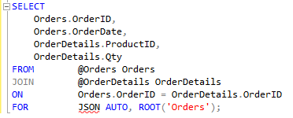
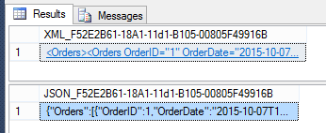
Jason who?
SSMS sees JSON as syntax error.
SSMS has no formatting or special handling for JSON results.

Slide 35
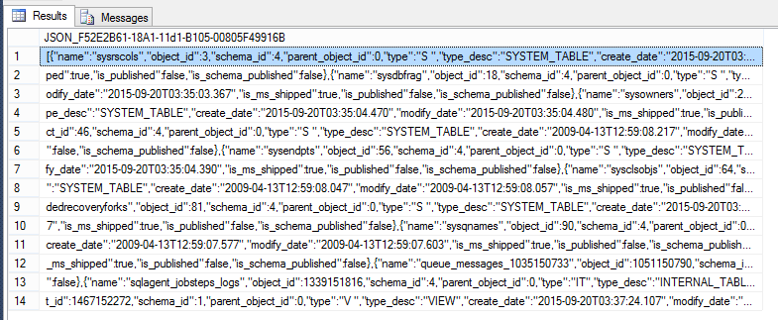
Yuck.

Slide 36
JSON Summary
FOR JSON
Works pretty much like FOR XML.
OPENJSON
Similar to OPENXML, but no need for separate “preparation” step (sp_xml_preparedocument).
ISJSON(@JSON)
Similar to TRY_CONVERT(xml, '<x>xml</x>')
JSON_VALUE(@JSON, '$.Order.Qty')
Similar to @XML.value

Slide 37
Temporal Tables
Like Apple’s Time Machine, but for your tables.
Can operate entirely transparently to existing applications.
Main table gets two extra time stamp fields.
History table:
Has same schema and stores old information.
Uses compression by default.
Can be queried directly.
Microsoft suggests using Azure stretch table.

Slide 38
Temporal Tables – Basic Syntax
CREATE TABLE OrderDetails
(
OrderDetailID bigint IDENTITY PRIMARY KEY,
OrderID bigint,
ProductID varchar(50),
Qty int,
EffectiveStart datetime2
GENERATED ALWAYS AS ROW START NOT NULL,
EffectiveStop datetime2
GENERATED ALWAYS AS ROW END NOT NULL,
PERIOD FOR SYSTEM_TIME (EffectiveStart, EffectiveStop)
)
WITH (SYSTEM_VERSIONING =
ON (HISTORY_TABLE = dbo.OrderDetailsHistory));
Notes:
Temporal Tables
https://msdn.microsoft.com/en-us/library/dn935015.aspx
CREATE TABLE (Transact-SQL)
https://msdn.microsoft.com/en-us/library/ms174979.aspx

Slide 39
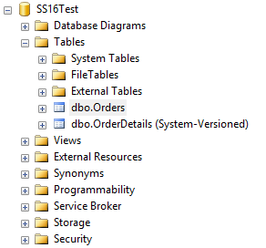
Temporal Tables – Time Travelling
SELECT *
FROM OrderDetails
FOR
SYSTEM_TIME
AS OF @dt
ORDER BY OrderDetailID;

Slide 40
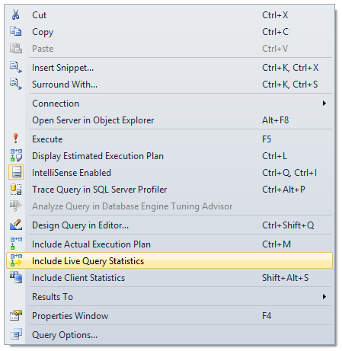
Live Query Statistics
Boom!
Wow.
“The performance impact of turning this on, on a production server, could be significant.” – Russ Thomas
☹
Notes:
You have to enable this in advance. You can’t just start monitoring an existing long-running query.
Coming Soon SQL 2016 Live Query Statistics (LQS)
https://sqljudo.wordpress.com/2015/06/02/coming-soon-sql-2016-live-query-statistics-lqs/
Live Query Statistics
https://msdn.microsoft.com/en-us/library/dn831878.aspx

Slide 41
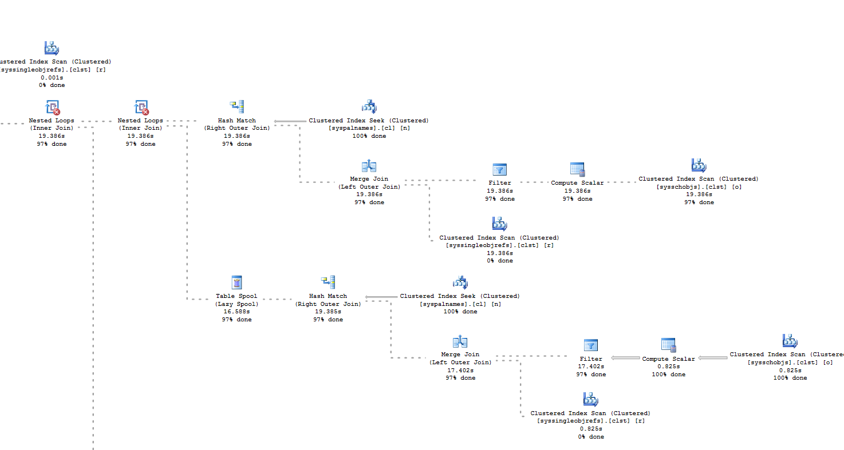
Feast your eyes…
Notes:
Coming Soon SQL 2016 Live Query Statistics (LQS)
https://sqljudo.wordpress.com/2015/06/02/coming-soon-sql-2016-live-query-statistics-lqs/

Slide 42
Can I play too?
Download and Install
Best with Virtualization.
2 gig for SQL Server download. 4 gig for Windows.
This can take several hours to download and set up.
Free for evaluation for 120 days.
TechNet Virtual Labs
Free, but limited options.
Azure Virtual Machine
SQL Server 2016 Pre-Installed
Azure SQL Database
Eventually
Notes:
TechNet Virtual Labs
https://technet.microsoft.com/en-us/virtuallabs
Azure Virtual Machine with SQL Server 2016
https://azure.microsoft.com/en-us/marketplace/partners/microsoft/sqlserver2016ctp2evaluationwindowsserver2012r2/?wt.mc_id=sqL16_vm
Download Link
https://technet.microsoft.com/en-in/evalcenter/mt130694.aspx

Slide 43
Path of Most Resistance
You need a VM host if you don’t want to mess with multiple SQL Server and SSMS versions on your main box.
VirtualBox is free and cross-platform.
You need an OS.
Windows 10 isn’t supported on VirtualBox (yet). You can get free evaluation version of Windows 8.1; lasts for 120 days.
If you have a spare license, you can download normal Windows 8.1 ISO. But you can’t use that for the evaluation version.
Notes:
You’ll need a VM Host:
https://www.virtualbox.org/wiki/Downloads
Install VirtualBox server.
You’ll need an OS:
If you have a licensed OS to spare:
http://windows.microsoft.com/en-us/windows-8/create-reset-refresh-media
Run and create ISO image
If you want an eval version:
http://www.microsoft.com/en-us/evalcenter/evaluate-windows-8-1-enterprise
You’ll need the CTP bits:
https://www.microsoft.com/en-us/evalcenter/evaluate-sql-server-2016
ISO/CAB/Azure?
https://technet.microsoft.com/en-gb/evalcenter/dn205290.aspx
ISO = DVD Image
CAB = “Normal” installation files (.box and .exe)
Azure = coordinate with Azure
Windows 10 ISO filename:
10240.16384.150709-1700.TH1_CLIENTENTERPRISEEVAL_OEMRET_X64FRE_EN-US.ISO
Windows 10 is not yet a recommended Guest OS:
https://www.virtualbox.org/wiki/Guest_OSes
Windows 8.1 ISO filename:
9600.17050.WINBLUE_REFRESH.140317-1640_X64FRE_ENTERPRISE_EVAL_EN-US-IR3_CENA_X64FREE_EN-US_DV9
SQL Server Install:
SQL Server 2016 Community Technology Preview 2.4
Evaluations | 180 days
SQLServer2016-x64-ENU.exe
SQLServer2016-x64-ENU.box
BOX is a compressed file format like zip.
Not easy to find info.
http://www.microsoftstore.com/store/msusa/en_US/DisplayHelpSoftwareDownloadsPage
The EXE appears to just explode the BOX into a folder.
Then run setup.exe.
But first, install .NET 3.5. You will need to download from Microsoft (if you don’t have an installation locally).
Windows Install
You don’t need a Windows Live (aka Microsoft) account
http://www.infobyte.hr/blog/337/windows-8-1-preview-how-to-install-without-microsoft-account-skip-microsoft-account/
Install VirtualBox Guest Additions
Quick Link
SQL Server 2016 CTP 2.4 Announcement
http://blogs.technet.com/b/dataplatforminsider/archive/2015/09/30/sql-server-2016-community-technology-preview-2-4-is-available.aspx
Ready-made Azure VM
https://azure.microsoft.com/en-us/marketplace/partners/microsoft/sqlserver2016ctp2evaluationwindowsserver2012r2/

Slide 44
Give me more. I can take it.
You need the SQL Server 2016 CTP bits.
ISO – Can burn to DVD or mount with software. In retrospect, this is the best option.
EXE + BOX (compressed file like a CAB or ZIP) – Can just run installation.
However, you need space to host uncompressed and compressed files *in* the VM.
Azure – Mostly useful if you are testing in an Azure VM.
Evaluation lasts for 180 days.

Slide 45
I’ve got all day.
Use VM software to make blank VM.
Mount ISO image using VM software.
Install Windows.
Enable .NET 3.5.
Install Java (if you want Polybase).
Install VM tools (to access files outside VM).
Install SQL Server.
So many updates!
Plenty of reboots, too.

Slide 46
Going for Broke
Which will require Enterprise edition?
Look at past enhancements:
2005 was almost all Standard Edition.
Since then, headline features are Enterprise.
But T-SQL features usually Standard.
“SQL Server 2014 Standard Edition Sucks, and It’s All Your Fault” – Brent Ozar, 2013-07-29
Notes:
SQL Server 2014 Standard Edition Sucks, and It’s All Your Fault [UPDATE]
http://www.brentozar.com/archive/2013/07/sql-server-2014-standard-edition-sucks-and-its-all-your-fault/
Editions and Components of SQL Server 2016
https://msdn.microsoft.com/en-us/library/ms144275.aspx

Slide 47
Place your bets…
Enterprise
PolyBase, R Algorithms in SQL
Big Data is Big Bucks
Dynamic Data Masking
Compliance is Big Bucks
Always Encrypted & Row-Level Security
TDE and Fine-Grained Auditing
Multiple Secondary Readers
AlwaysOn AGs
Temporal Tables
Change Data Capture, Uses Compression
Notes:
“By default, the history table is PAGE compressed.”
Temporal Tables
https://msdn.microsoft.com/en-us/library/dn935015.aspx

Slide 48
The Crumbs
Standard
JSON
XML
Stretch Database
Previous Azure Support
Automatic TempDB Optimization
Buffer Pool & Delayed Durability
Live Query Statistics & Query Store
Most “RDBMS Manageability” is in Standard
Notes:
Features Supported by the Editions of SQL Server 2014
https://msdn.microsoft.com/en-US/library/cc645993(v=sql.120).aspx
JSON in Standard (and express):
“First of all, this is going to be standard functionality available in all editions, even Express.”
http://blogs.sqlsentry.com/aaronbertrand/sql-server-2016-json-support

Slide 49
Say Goodbye
SQL Server 2016 will discontinue and/or break some features, but they are “to be determined”.
Notes:
Discontinued Database Engine Functionality in SQL Server 2016
https://msdn.microsoft.com/en-US/library/ms144262.aspx

Slide 50
Steer Clear
Discontinued in next version
SET ROWCOUNT for data modification.
Use TOP instead.
Result Sets from Triggers
Remote Servers
Use Linked Servers instead.
Still kicking:
Database Mirroring
Omitting Semicolons
Notes:
Deprecated Database Engine Features in SQL Server 2016
https://msdn.microsoft.com/en-us/library/ms143729.aspx

Slide 51
The People Have Spoken
JSON Support is #1 Connect Item
1070 Up-Votes
But…
CREATE OR REPLACE
7th Most Popular (442 Up-Votes)
Created in March of 2005
Notes:
Add native support for JSON to SQL Server, a la XML (as in, FOR JSON or FROM OPENJSON) By - bret_m_lowery
https://connect.microsoft.com/SQLServer/Feedback/Details/673824

Slide 52
Shut Up and Take My Money
“While this has also been hotly requested, I’d caution you to be careful what you ask for. Users demanded XML support inside SQL Server, and then proceeded to use SQL Server as an XML query engine, sending CPU through the roof. SQL Server is one of the world’s most expensive application servers.”
– Brent Ozar, 2015-05-04
Notes:
Reading the SQL Server 2016 Data Sheet
http://www.brentozar.com/archive/2015/05/reading-the-sql-server-2016-data-sheet/

Slide 53
In the year 2000…
SQL Server 2018?
Brent Ozar: VMs mean 2005 & 2008 4eva
Other popular Connect items:
Better Error Info for “String… truncated”
Error Table for Big Insert/Update Failures
Inline Scalar UDFs
Full Regex for LIKE, etc.
Built-in Tally Table (Table of Numbers)
Read/Write Table-Valued Parameters
Notes:
Most of the popular Connect items are T-SQL or developer-centric improvements but they haven’t been getting a lot of love recently. It’s all about Big Data and big speed.
Databases Five Years from Today
http://www.brentozar.com/archive/2013/03/databases-five-years-from-today/
Connect items:
Please fix the "String or binary data would be truncated" message to give the column name By – Dwalker
https://connect.microsoft.com/SQLServer/Feedback/Details/339410
new virtual table: errors. It would analogous to the deleted and inserted tables By - danholmes
https://connect.microsoft.com/SQLServer/Feedback/Details/774754
The Scalar Expression function would speed performance while keeping the benefits of functions. - by Andrew Novick
https://connect.microsoft.com/SQLServer/Feedback/Details/273443
Regex functionality in pattern matching By - Simon Sabin
https://connect.microsoft.com/SQLServer/Feedback/Details/261342
Add a built-in table of numbers By - Erland Sommarskog
https://connect.microsoft.com/SQLServer/Feedback/Details/258733
Relax restriction that table parameters must be readonly when SPs call each other. By - Erland Sommarskog
https://connect.microsoft.com/SQLServer/Feedback/Details/299296

Slide 54
Riley Major
@RileyMajor | PASSMN@RileyMajor.com
Enterprise Architect
Manna Freight Systems, Inc.
Worked with SQL Server since May of 2000
PASSMN Board – Director of Technology
Conference speaker
Father of three girls

Slide 55
Evaluations Please
Remember to fill out your online evaluations for the event and any sessions you have attended. They will be online until 10/17/15.
http://www.sqlsaturday.com/453/eventeval.aspx
http://www.sqlsaturday.com/453/sessions/sessionevaluation.aspx

